Slide 1

Vel Tech Rangarajan Dr. Sagunthala R&D Institute of Science and Technology
School of Computing
Department of Computer Science and Engineering
10211CS224 / FULL STACK APPLICATION DEVELOPMENT (JAVA)
PROJECT REVIEW : MILESTONE PROJECT – 1
Date: 23-03-2026
Subscription-Based Membership Engine with Tiered Logic
SDG: SDG 9– Industry , Innovation & Infrastructure
Presented By:
K . VAMSI KRISHNA – VTU26432 – 23UECS0755.
Courses Handling Faculty:
Dr. S . HEMAMALINI – M.E., Ph.D.,

Slide 2
INTRODUCTION
Background of the problem:
Many platforms do not provide proper subscription control and secure user access to content.
Why this project is important:
It allows users to register, log in, select plans, and access content based on their subscription.
Real-world relevance:
Useful for OTT platforms, online learning systems, and membership-based applications.
Brief overview of the system:
mantra.com is a subscription-based web application that provides tier-based content access with authentication and deployment using Netlify.
1
2
3
4
5
6
7
8
9

Slide 3
PROBLEM STATEMENT
Many digital content platforms do not provide an efficient system for user authentication, subscription management, and controlled access to premium content. This makes it difficult to manage users, restrict content based on membership levels, and provide a smooth user experience. There is a need for a simple, secure, and automated subscription-based web application that allows users to register, log in, choose suitable plans, and access content according to their subscription.
1
2
3
4
5
6
7
8
9

Slide 4
OBJECTIVES
To design and develop a web-based subscription platform that allows users to register, log In securely, and manage their accounts.
2. To implement tier-based subscription plans (Basic, Gold, and Premium) that control access to content based on user membership.
3. To provide a responsive and user-friendly interface for accessing images and videos across different devices.
1
2
3
4
5
6
7
8
9

Slide 5
PROPOSED SYSTEM
The proposed system is a web-based subscription platform that manages user registration, login, subscription plans, and content access in one application.
2. It allows users to create an account, log in securely, and choose a suitable subscription plan (Basic, Gold, or Premium).
3. The system provides controlled access to images and videos based on the selected membership level.
4. Content is displayed in a responsive and organized grid layout for better user experience.
5. The application includes features like likes, search, and smooth navigation to enhance user interaction.
6.The system is fully automated and reduces manual effort in managing users and content.
7.It ensures secure and accurate handling of user data and subscription logic.
8.The application is deployed on a cloud platform, making it accessible anytime on mobile and desktop devices.
1
2
3
4
5
6
7
8
9

Slide 6
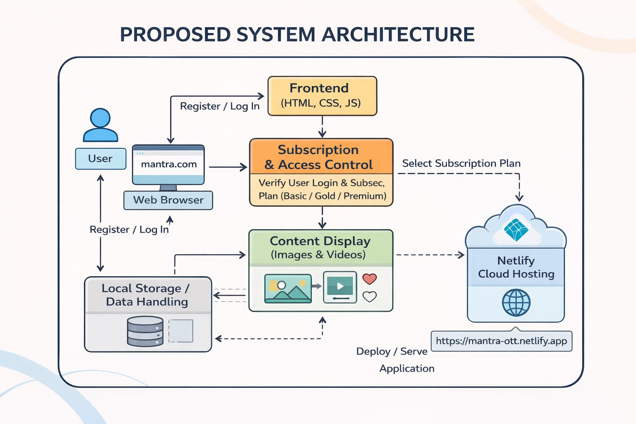
PROPOSED SYSTEM ARCHITECTURE
1
2
3
4
5
6
7
8
9

Slide 7
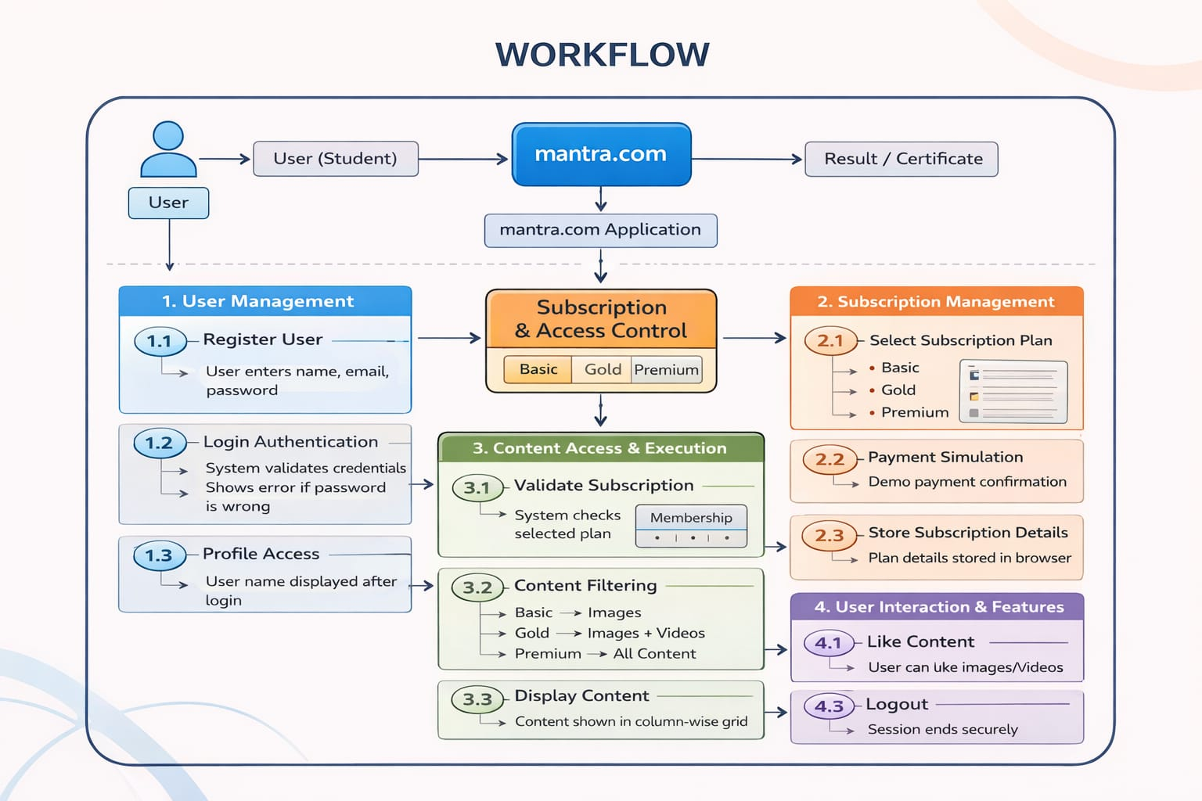
WORKFLOW
(Add dataflow diagram)
1
2
3
4
5
6
7
8
9

Slide 8
TECHNOLOGIES USED
Frontend:
1.HTML5
2.CSS3
3.Javascript
Database:
1.XAMPP(apache+MySQL)
Software Requirements:
1.Operating System
2. Web Browser
3.Intrenet Connection
Tools:
1.visual Studio code
2.Web Browser
1
2
3
4
5
6
7
8
9

Slide 9
MODULE DESCRIPTION
Module 1: User Management
Handles user registration, login authentication, and user session management. Displays the user name after successful login and ensures secure access.
Module 2: Subscription Management
Allows users to select subscription plans such as Basic, Gold, and Premium. Stores subscription details and controls user access based on the selected plan.
Module 3: Content Management
Manages the display of images and videos in a responsive grid layout. Provides features like search and likes for better user interaction.
Module 4: Access control & Session Handling
Validates subscription plans and restricts or allows content access accordingly. Handles logout and session termination securely.
1
2
3
4
5
6
7
8
9

Slide 10
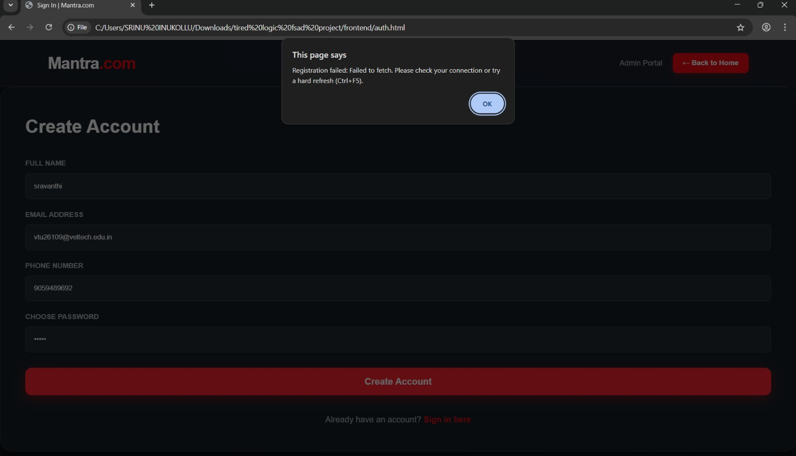
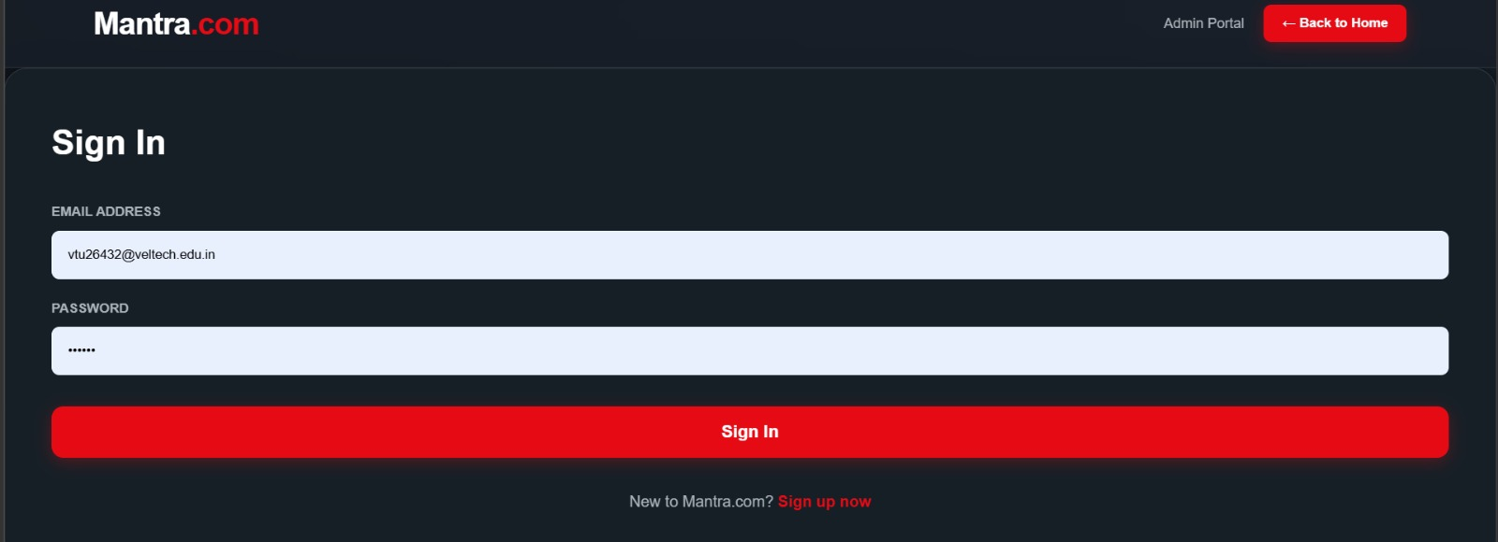
IMPLEMENTATION SCREENSHOTS
Register/sign in:
1
2
3
4
5
6
7
8
9

Slide 11
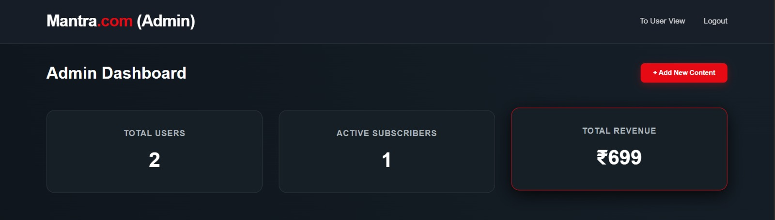
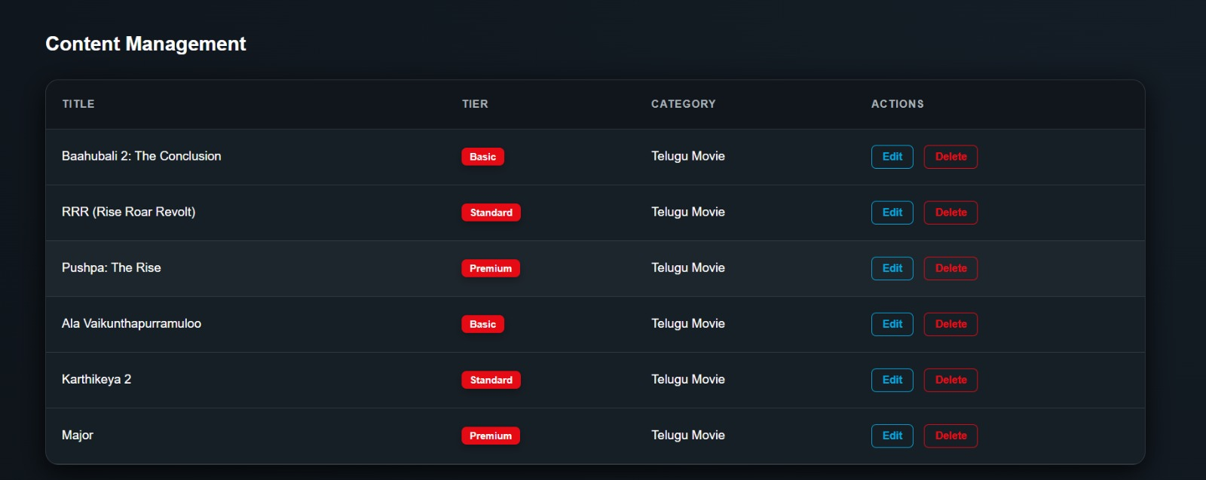
IMPLEMENTATION SCREENSHOTS
Admin page :
1
2
3
4
5
6
7
8(A)
9

Slide 12
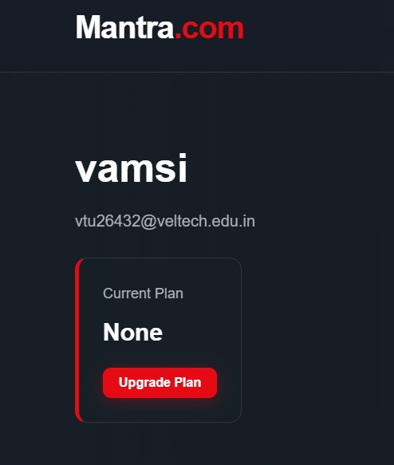
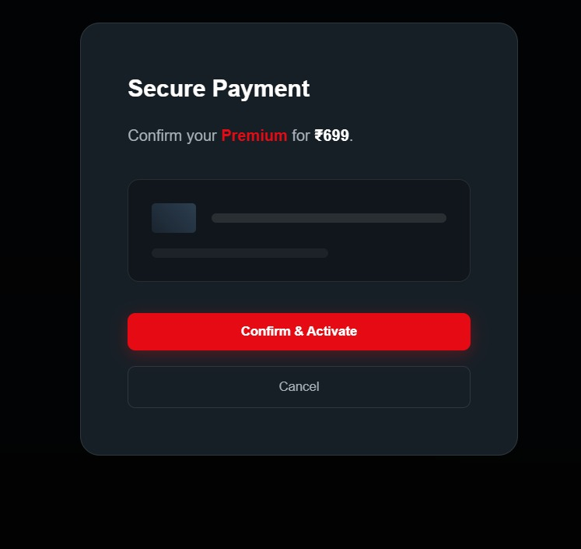
IMPLEMENTATION SCREENSHOTS
1
2
3
4
5
6
7
8(B)
9

Slide 13
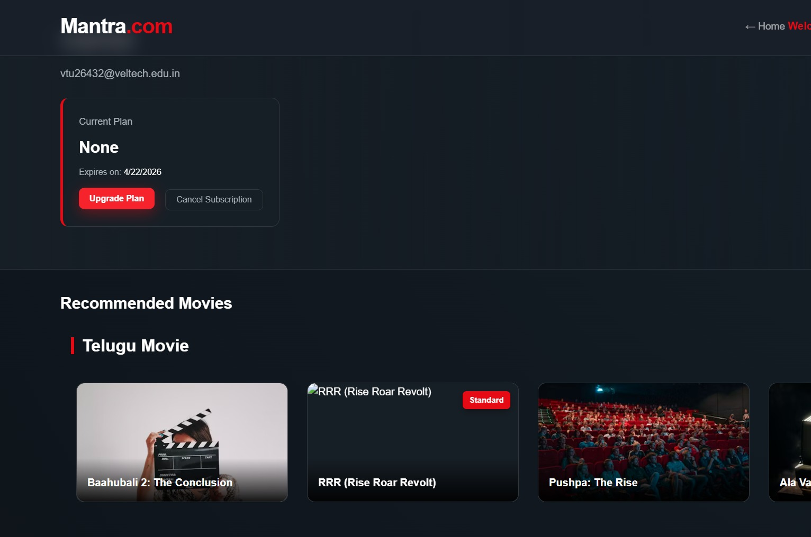
IMPLEMENTATION SCREENSHOTS
1
2
3
4
5
6
7
8(C)
9

Slide 14
ADVANTAGES & LIMITATIONS
Advantages:
1. Simple and user-friendly registration and login system.
2. Subscription-based content access (Basic, Gold, Premium).
3. Responsive design that works on mobile and laptop devices.
4. Cloud deployment using Netlify provides easy global access.
Limitations:
1. Uses client-side storage, so data is limited to the browser.
2. No real payment gateway (demo payment only).
3. Requires internet connection to access hosted content.
4. Limited security compared to full backend-based systems.
1
2
3
4
5
6
7
8
9

Slide 15
Thank you

